Slide 1
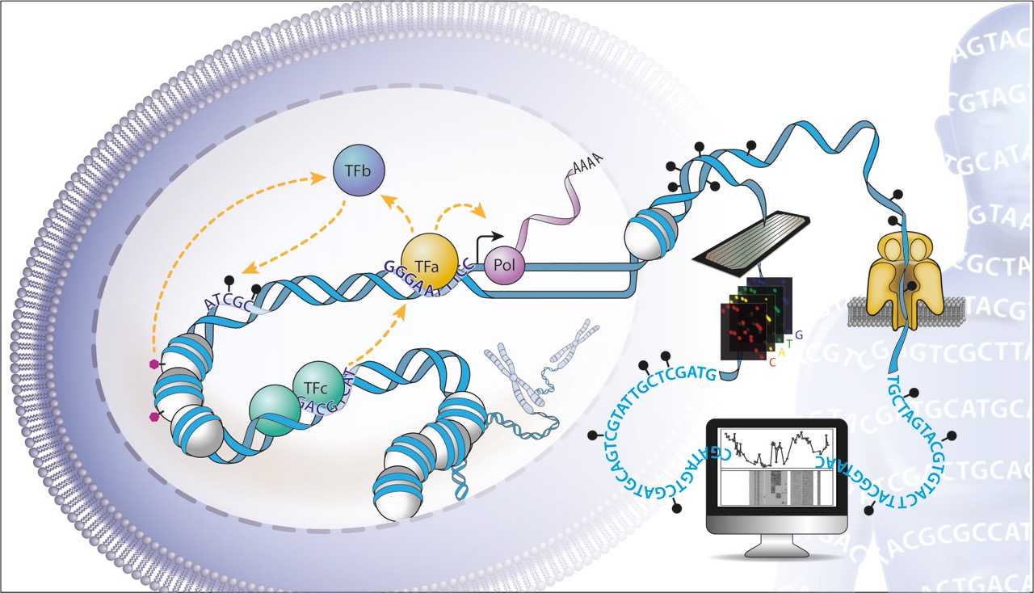
Single Molecule Footprinting (SMF)
wet and dry lab insights
Guido Barzaghi &
Kasit Chatsirisupachai
Predoc course Krebs practical
30.11.22

Slide 2
First for some biology …
Notes:
\

Slide 3
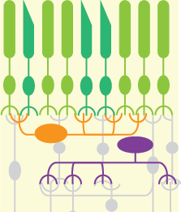
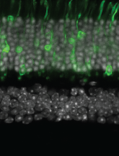
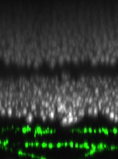
Genomic organisation of transcriptional regulation
Pol II
enhancer
promoter
gene
How is genetic information translated into gene expression patterns ?
retina
Light
perception
<300bp
Signal
Integration
>55 cell types
Hartl D, et al, NAR. 2017
Jütenner J, et al, Nature Neuroscience 2019
Notes:
\

Slide 4
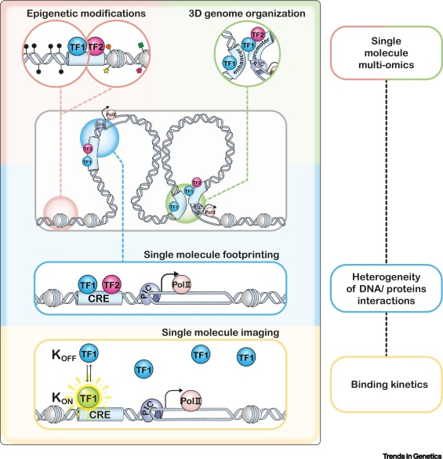
Molecular phenomena we can study with SMF
Kreibich E et al, In revision 2021
Boulanger M. et al, ongoing prj.
Krebs A et al, Mol Cell 2017
Sönmezer C et al, Mol Cell 2021
Krebs A, Trends in Genetics 2021
Notes:
\

Slide 5
Molecular phenomena we can study with SMF
Established Single Molecule Footprinting
in drosophila
Revealed that absence elongation is likely
due to premature termination rather
than stable PolII stalling
Krebs A et al, Mol Cell 2017
Krebs A, Trends in Genetics 2021
Notes:
\

Slide 6
Molecular phenomena we can study with SMF
Established Single Molecule Footprinting
in mouse
Revealed that TF cooperative binding is a
widespread gene regulatory mechanism
across the mammalian genome and that
it does not depend on TF identity
Sönmezer C et al, Mol Cell 2021
Krebs A, Trends in Genetics 2021
Notes:
\

Slide 7
Molecular phenomena we can study with SMF
Kreibich E et al, In revision 2021
Established analysis pipelines for
multi-omics data integration in SMF
Revealed that CpG methylation does not
influence enhancer accessibility in most
cases, but identified a class of CREs
regulated by DNA methylation
Krebs A, Trends in Genetics 2021
Notes:
\

Slide 8
… why and how …
Notes:
\

Slide 9
Single Molecule Footprinting (SMF)
Bulk assay:
Single molecule assay:
N cells
Signal=∑ binding / N
Signal= abundance of a binding state

Slide 10

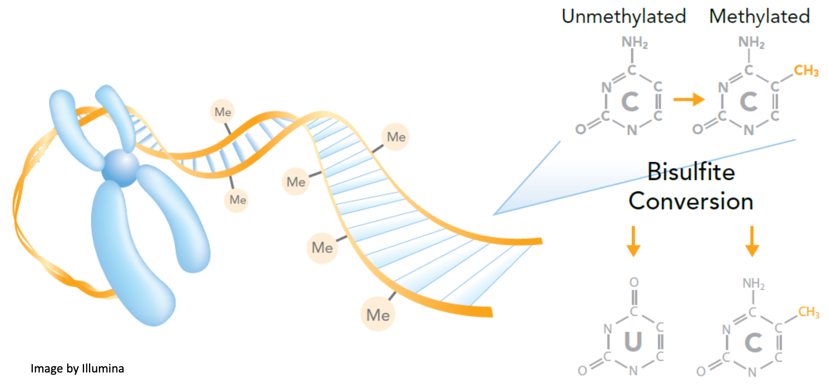
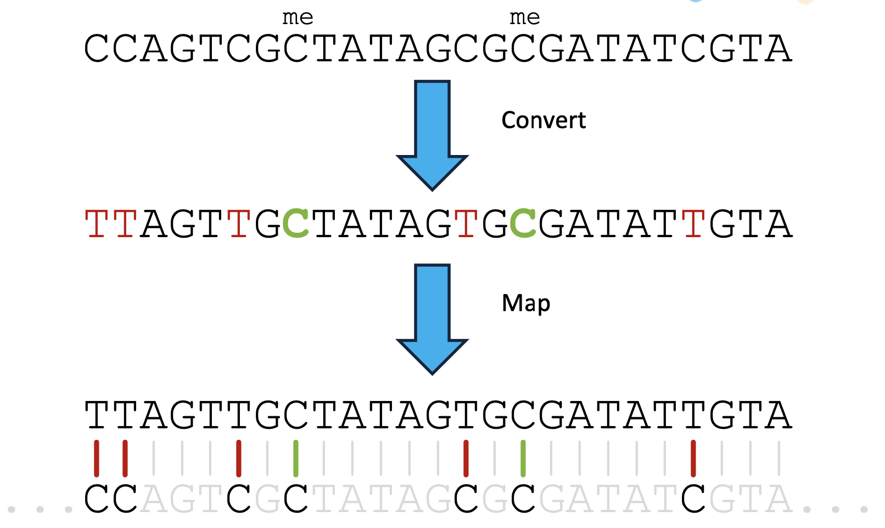
The Bisulfite conversion for sequencing
v
v
v
Sequencing
read
Reference
genome
Adapted from Felix Krueger
Mostly used to detect endogenous CpG methylation,
we use it for GpC methylation deposited with a recombinant enzyme

Slide 11

Principles of Single Molecule Footprinting (SMF)
Methyl-
transferase
accessible
Single Molecule Footprinting
Krebs AR, et al. Mol Cell 2017
cell 1
single cell
(ATAC, DNAse, NOMe)
cell 2
cell 3
cell 4
Krebs AR, et al. Trends in Genetics 2021

Slide 12
… now a technical bit …
Notes:
\

Slide 13
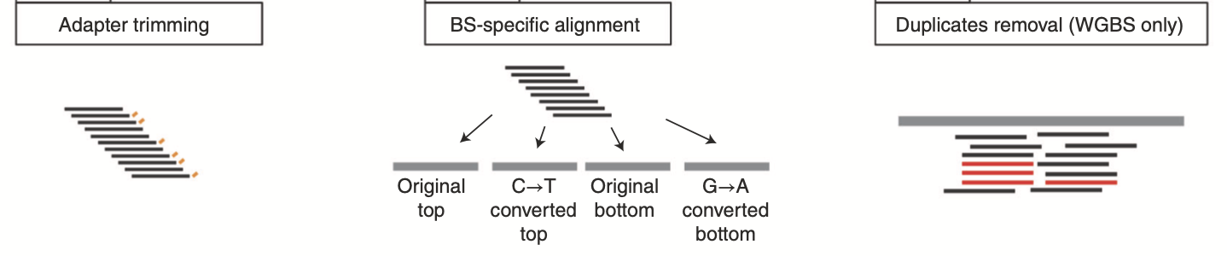
The Computational Protocol (preprocessing)
Performed with standard tools
(Trimmomatic/TrimGalore, QuasR (Bowtie), Picard, …)
Kleinendorst R. & Barzaghi G. et al, Nature Protocols 2021

Slide 14
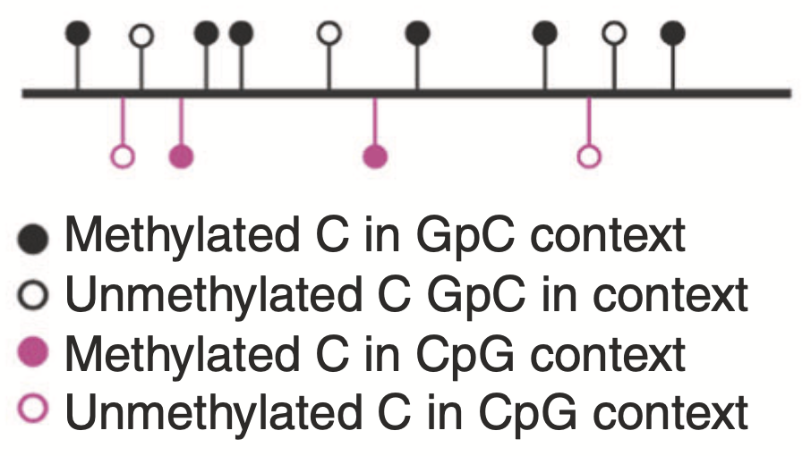
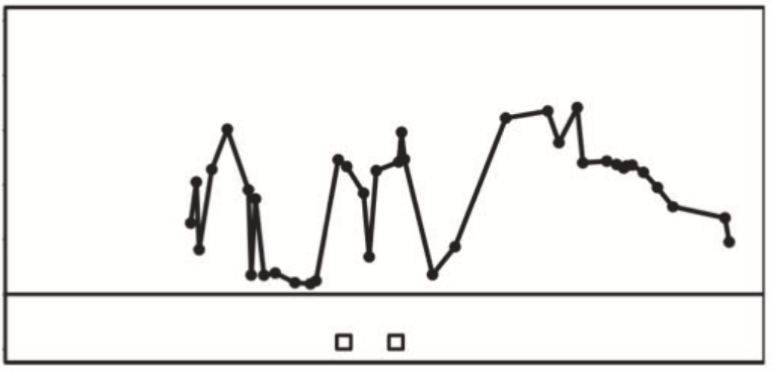
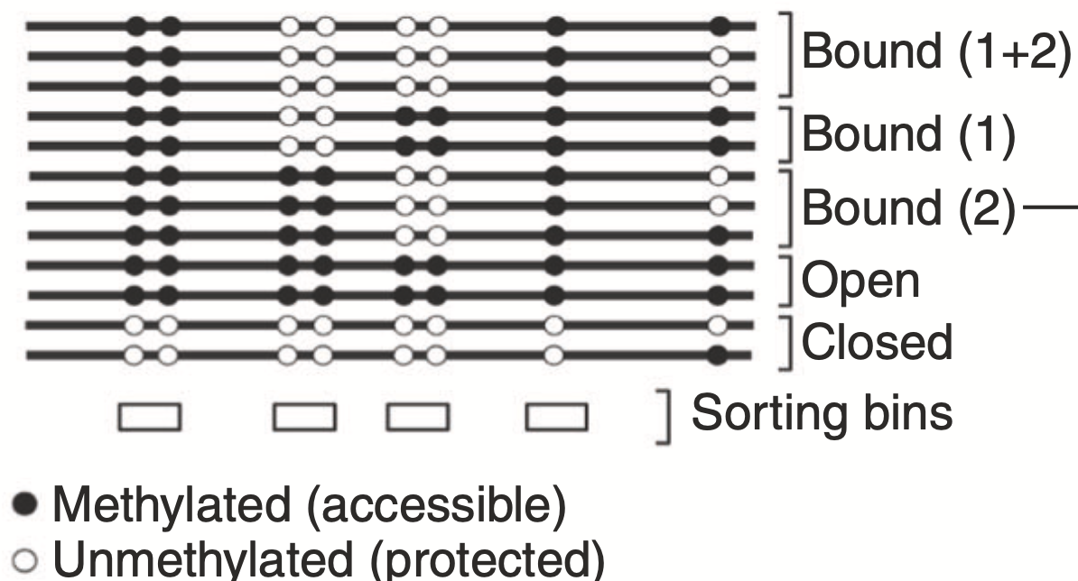
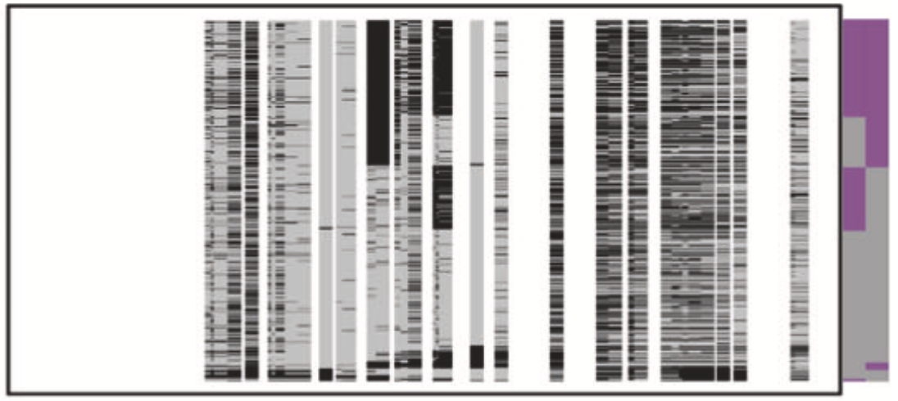
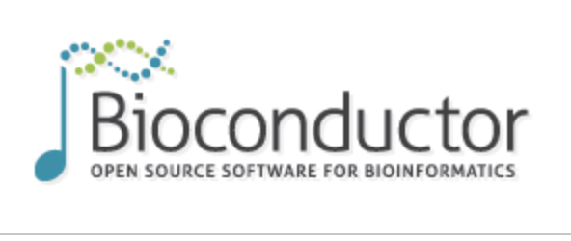

The Computational Protocol (SMF analysis)
Call Context Methylation
Identify features of interest
Sort reads by feature of interest
Quantify biological states
m %
Performed with the Bioconductor
package SingleMoleculeFootprinting
n %
p %
q %
Mike Smith
Kleinendorst Rozemarijn & Barzaghi Guido et al, Nature Protocols 2021

Slide 15
… today’s exercise …
Notes:
\

Slide 16
Question
We use two enzymes to footprint
M.SssI […CpG…]
M.CviPI […GpC…]
Is there any sequence dependence of these enzymes beyond their targets?
Is the concentration of the enzyme relevant?
Bonus question: do these enzymes have any off-target sites?

Slide 17
Data
We performed in vitro methylation footprinting on naked lambda DNA.
We did two experiments in parallel (one per enzyme).
We methylated at increasing enzymatic concentrations.

Slide 19
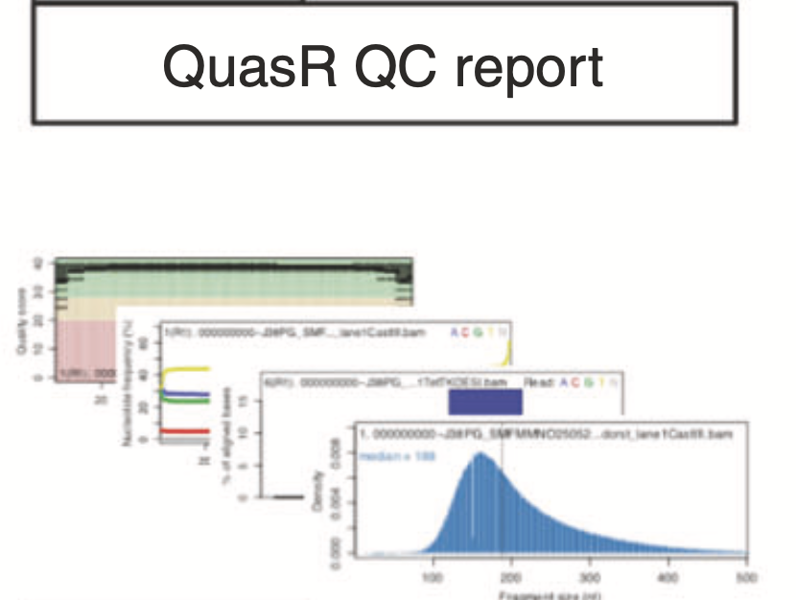
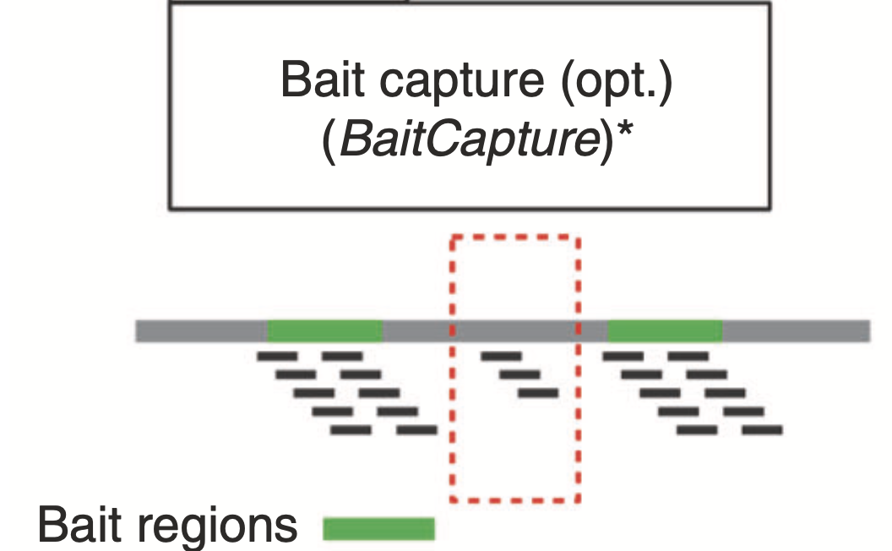
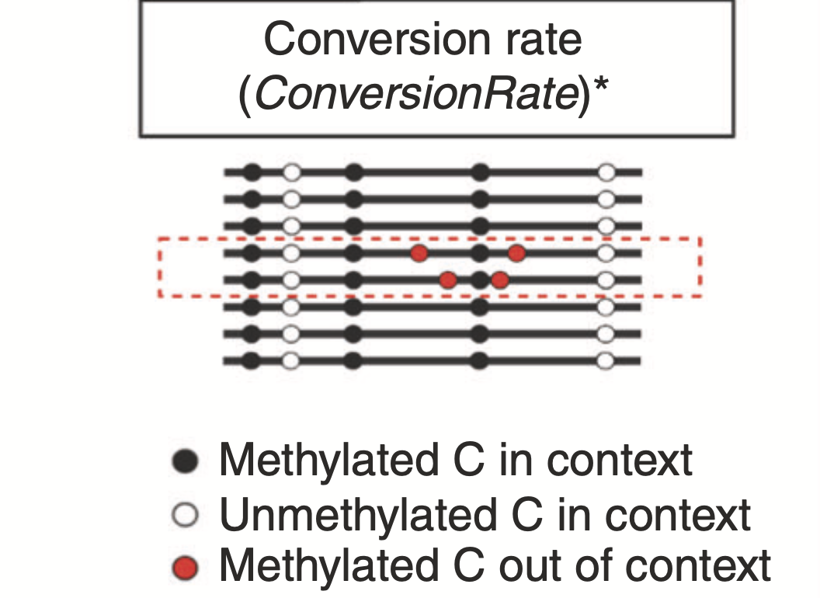
The Computational Protocol (QCs)
Performed with the Bioconductor
package SingleMoleculeFootprinting
Mike Smith
Kleinendorst Rozemarijn, Barzaghi Guido et al, Nature Protocols 2021

Slide 20
Call Context Methylation
The function `CallContextMethylation` performs following steps:
Single-enzyme
(GC only)
Identify methylation status for the cytosines
Based on experiment contexts
Double-enzyme
(GC and CG)
No enzyme
(endogenous CG only)
Filter reads by conversion rate
Context methylation matrix
Collapse strands
 | Cytosine 1 | Cytosine 2 | Cytosine 3 | …
Read 1 | 1 | 0 | 1
Read 2 | 0 | 1 | 1
Read 3 | 1 | 0 | 0
…
Filter reads by coverage

Slide 21
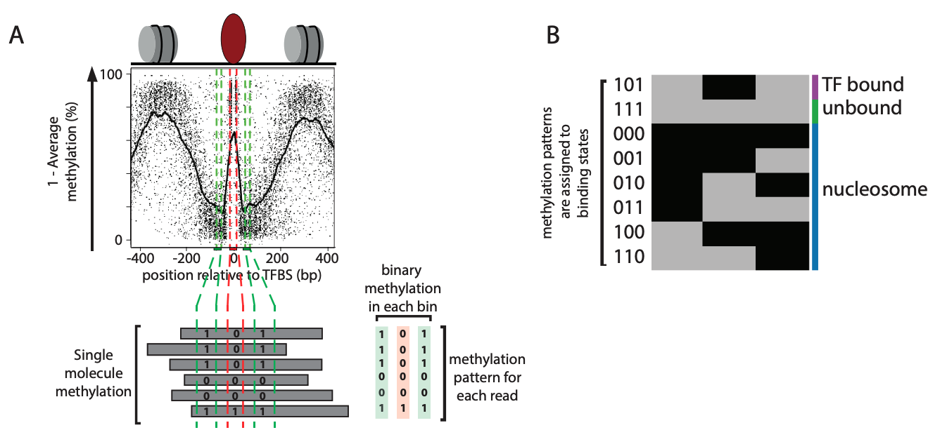
Molecular Sorting: quantify number of molecules in each state
Define sensible sorting bins around region of interests (e.g. TF binding sites, transcription start sites)
Average methylation of cytosines that located within the bins and assign one single value for each bin (0 or 1)
Define binding states from a combination of bins
*** Only reads that are spanning all bins are included in the analysis ***
Sönmezer et al., 2021

Slide 22
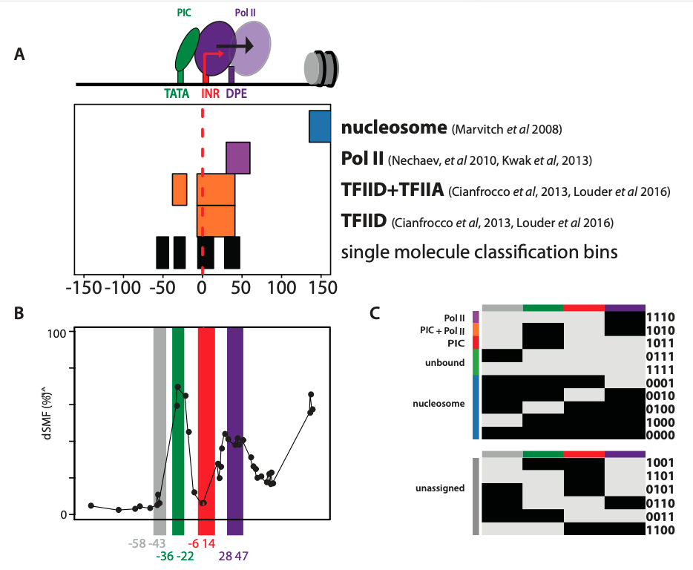
Molecular Sorting: quantify number of molecules in each state
Promoter
Krebs et al., 2017

Slide 23
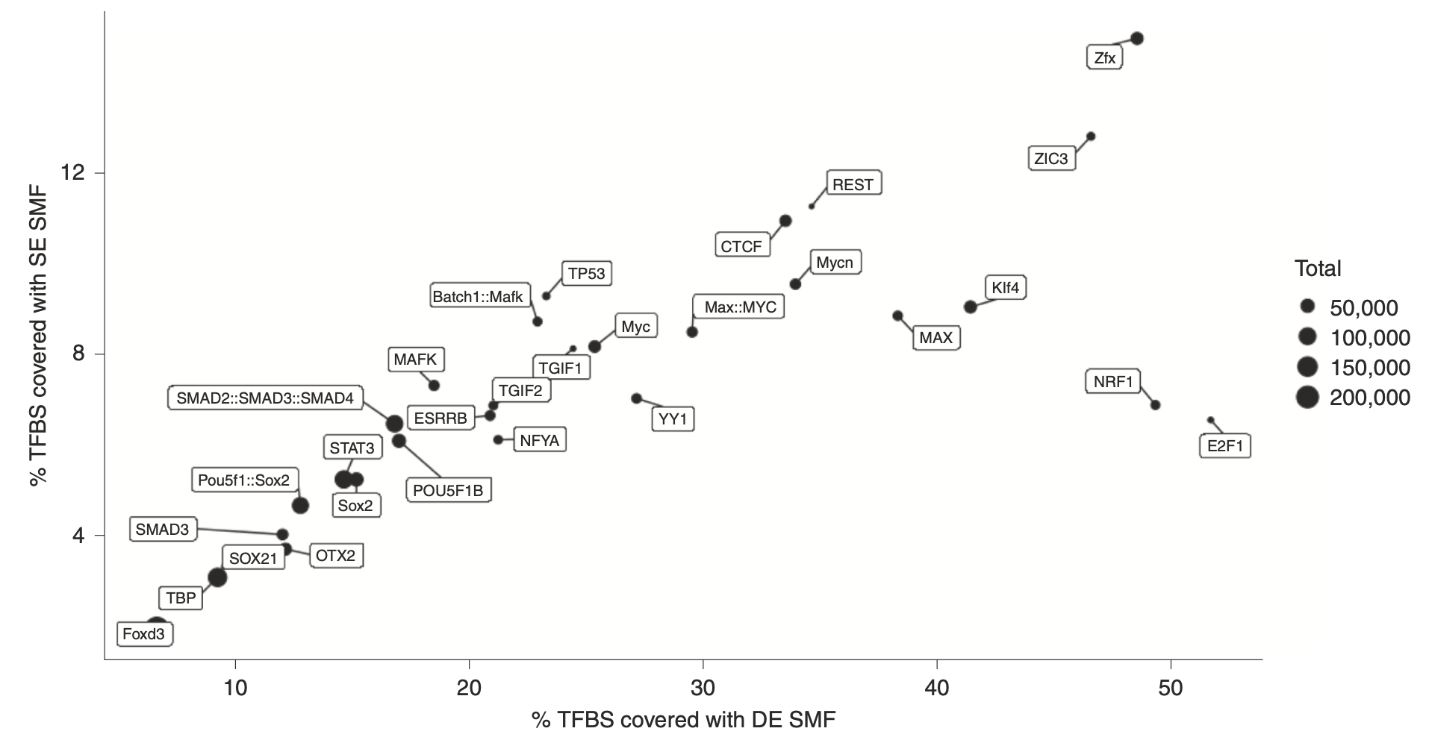
The choice of footprinting strategy
Kleinendorst Rozemarijn, Barzaghi Guido et al, Nature Protocols 2021

Slide 24
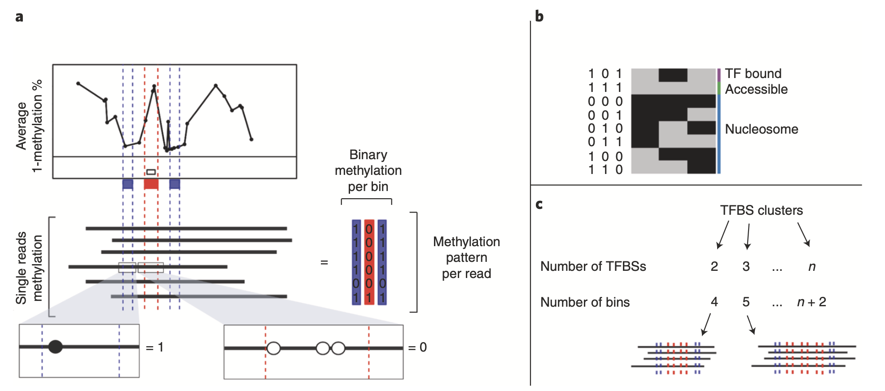
Single molecule sorting
Kleinendorst Rozemarijn, Barzaghi Guido et al, Nature Protocols 2021

